Slide 1



Car Wash start-up location Analysis
By Evan Manon
Data analyst apprentice

Slide 2


motivation
Desire to open a business
Interest in cars
Always keeping car clean
Love to see cars shine
Want to own car wash

Slide 3
agenda
Chosen Location
Population
Income Per Capita
Annual Average Daily Traffic (AADT)
Demographics
Existing Car Wash Locations
Financial Projections
Ingredients for Success
Location Strengths

Slide 4
Washington County vs. Tennessee average

Slide 5
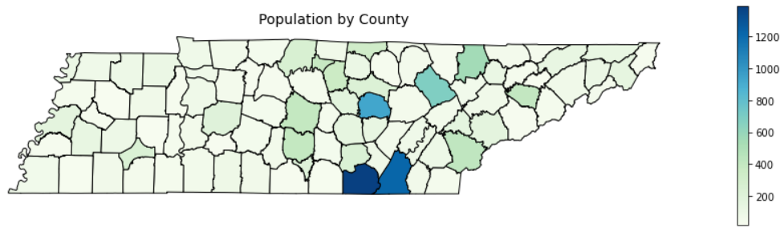
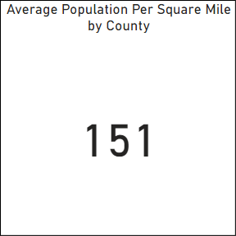
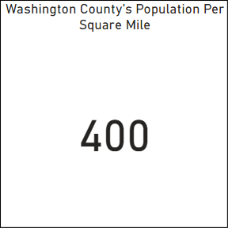
Population per square mile
Washington County

Slide 6
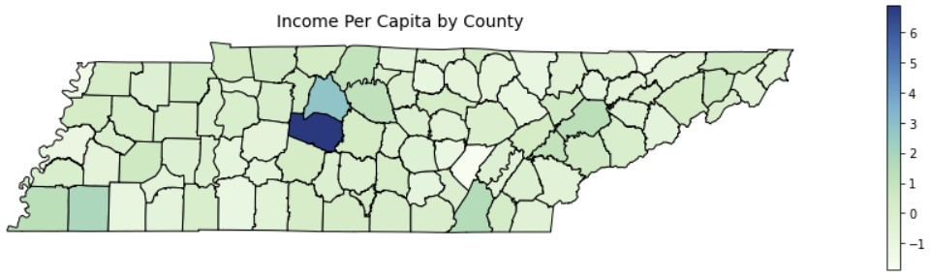
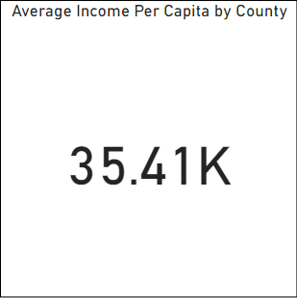
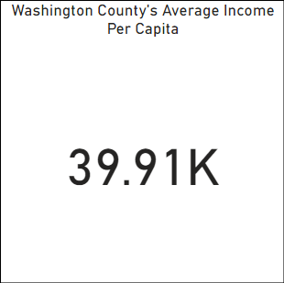
Income per capita
Washington County

Slide 7
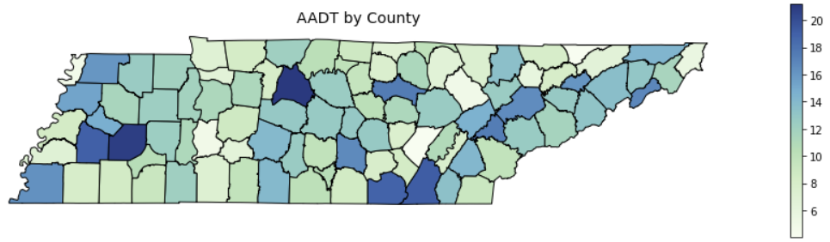
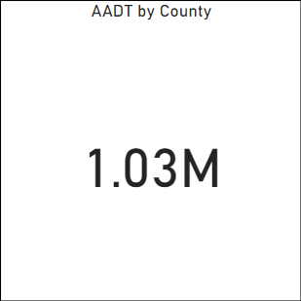
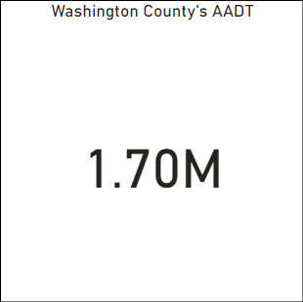
Annual Average Daily Traffic
Washington County

Slide 8
Why Washington county?

Slide 9
car wash key ingredients
Road-view Commercial Real Estate
Above Average Income Per Capita
AADT of 15,000+
Demand for Car Wash
Affordable Land Prices
Higher Middle-aged Population
Near Major Intersection

Slide 10
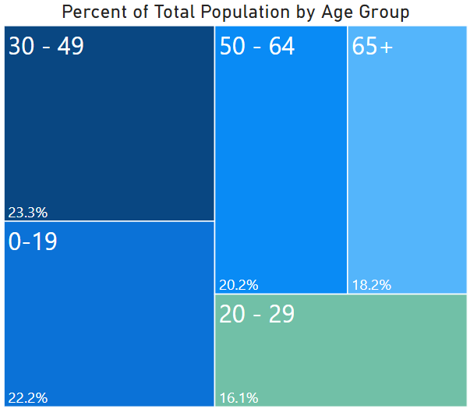
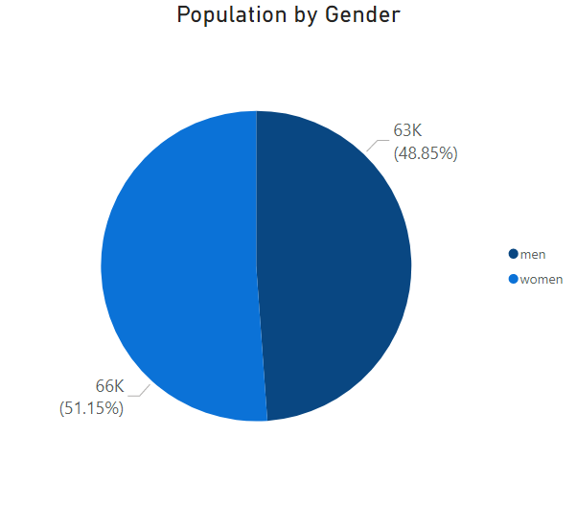
Age/gender demographics

Slide 11
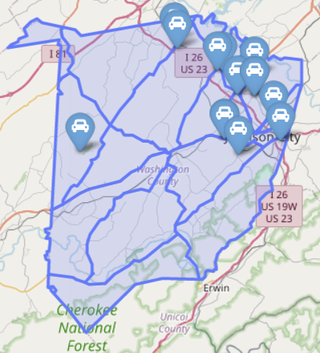
Existing car wash locations
Existing car wash locations (13)
In bay/self service (10)
Tunnel (2)
Mobile (1)

Slide 12
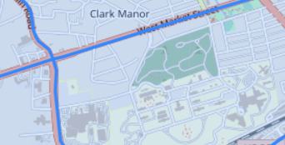
Location strengths
Proposed Car Wash Location
18,510 AADT
Near large intersection
Affordable land
Closest car wash is 2+ miles away
No full-service car washes in area
Road-view property

Slide 13
Variables used for financial projection
Capture rate of 0.4%
Average ticket cost of $15.00
10 Part-time employees
Employee pay of $9/hour
Car wash open 350 days a year
Car wash Open 9 hours a day

Slide 14
Construction and material costs
Start Up Costs | Price
Land | $ 75,000.00
Building Permit | $ 2,184.00
Sewer/Discharge Permit | $ 25.00
Signage Permit | $ 300.00
Architect Drawings | $ 40,000.00
Site Work | $ 250,000.00
Building Construction | $ 185,000.00
Conveyer Material/Install | $ 211,000.00
Utility Tap-ins | $ 10,000.00
Signage | $ 20,000.00
Marketing | $ 5,000.00
Security System | $ 10,000.00
Vacuums | $ 5,000.00
Employee Pay (1-Year) | $ 135,000.00
Misc. Equipment | $ 40,000.00
Canopy/Awnings | $ 6,024.00
Total | $ 994,533.00

Slide 15
Expense Calculations
Per car/daily expenses
Total monthly/annual expenses
Expenses | Cost Per Car | Daily Total
Electricity | $ (0.50) | $ (37.02)
Natural Gas | $ (0.12) | $ (8.88)
Water | $ (0.16) | $ (11.85)
Detergents/Chemicals | $ (0.64) | $ (47.39)
Repairs/Maintenance | $ (0.47) | $ (34.80)
Administrative Expenses | $ (1.00) | $ (74.04)
Employee Pay | $ (5.25) | $ (388.35)
Total | $ (8.14) | $ (602.33)
Expenses | Monthly Cost | Annual Cost
Electricity | $ (1,080.98) | $ (12,957.00)
Natural Gas | $ (259.44) | $ (3,109.68)
Water | $ (345.91) | $ (4,146.24)
Detergent/Chemicals | $ (1,383.66) | $ (16,584.96)
Repairs/Maintenance | $ (1,016.12) | $ (12,179.58)
Administrative Expenses | $ (2,161.97) | $ (25,914.00)
Employee Pay | $ (11,339.82) | $ (135,922.50)
Loan | $ (4,850.00) | $ (58,200.00)
Total Expenses | $ (22,437.91) | $ (269,013.96)

Slide 16
1-year financial projections
Start-up
$994,533
Gross Income
$388,710
Expenses
$269,014
Profit
$119,696
Profit Margin
30.79%

Slide 17
Assumption references
Architectural Fees. (n.d.). Commercial Architectural Fees. Retrieved from http://architecturalfees.com/commercial-architectural-fees/
C&S. (2020). Car Washes/Vacuum Canopies. Retrieved from https://cscanopy.com/services/carwashes/
DetailXPerts. (2020, December 04). What's the Average Cost to Build a Car Wash? Retrieved from https://www.detailxpertsfranchise.com/blog/2017/06/08/whats-the-average-cost-to-build-a-car-wash/
Glover, B. (n.d.). What Does It Cost To Build A Car Wash. Retrieved from https://carwashbusiness101.com/what-does-it-cost-to-build-a-car-wash/
Johnson City Tennessee. (2018). Regional Rate Schedule. Retrieved from https://www.johnsoncitytn.org/document_center/water/FY18-19%20Rates%20Tap%20Sheet-Outside%20City.pdf
Johnson City Tennessee. (n.d.). Application for Sign Perm. Retrieved from https://www.johnsoncitytn.org/document_center/Development%20Services/Codes/permit%20applications/Application%20for%20Sign%20Permit%2019.pdf
Johnson City Tennessee. (n.d.). Building Permit Fee Schedule. Retrieved from https://www.johnsoncitytn.org/document_center/Development%20Services/Codes/Building%20Permit%20Fee%20Schedule.pdf
LoopNet. (2020). E Main St @ Indian Ridge Rd - Corner Lot Adjacent to VA. Retrieved from https://www.loopnet.com/Listing/E-Main-St-Indian-Ridge-Rd-Johnson-City-TN/11580803/
MTAS. (n.d.). Water and Sewers. Retrieved from https://www.mtas.tennessee.edu/system/files/codes/JohnsonCity_t18.pdf
WillyGoat. (2020). Hip Roof Shade Structure with 4 Posts and 14 Foot Entry. Retrieved from https://willygoat.com/products/hip-roof-shade-structure-with-4-posts-and-14-foot-entry?variant=31908609917025

Slide 18
Data References
ArcGIS Hub. (2018). TIGER Line 2018 Tennessee Counties. Retrieved from https://hub.arcgis.com/datasets/b3b22bda38d54d0686efb4a9d60c8d1b_0/data
Census Reporter. (2019). ACS 2019 1-year. Retrieved from https://censusreporter.org/data/table/?table=B01001
Google. (2020). Place Search. Retrieved from https://developers.google.com/places/web-service/search
Index Mundi. (2010). Tennessee Land area in square miles, 2010 by County. Retrieved from https://www.indexmundi.com/facts/united-states/quick-facts/tennessee/land-area
TDOT. (2019). Traffic History. Retrieved from https://www.arcgis.com/apps/webappviewer/index.html?id=075987cdae37474b88fa400d65681354
Tennessee. (2016). Personal Income Per Capita. Retrieved from https://data.tn.gov/dataset/personal-income-per-capita/resource/047c6a4b-1ab3-4589-b04d-32ad95c751b8
World Population Review. (2020). Population of Counties in Tennessee (2020). Retrieved from https://worldpopulationreview.com/us-counties/states/tn

